Slide 1


Emotional Intelligence:
The Value Proposition
Read the supporting article for this resource: https://www.genosinternational.com/business-case/

Slide 2
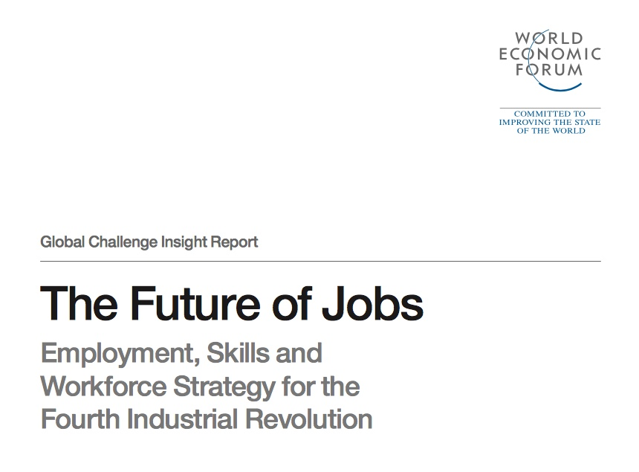
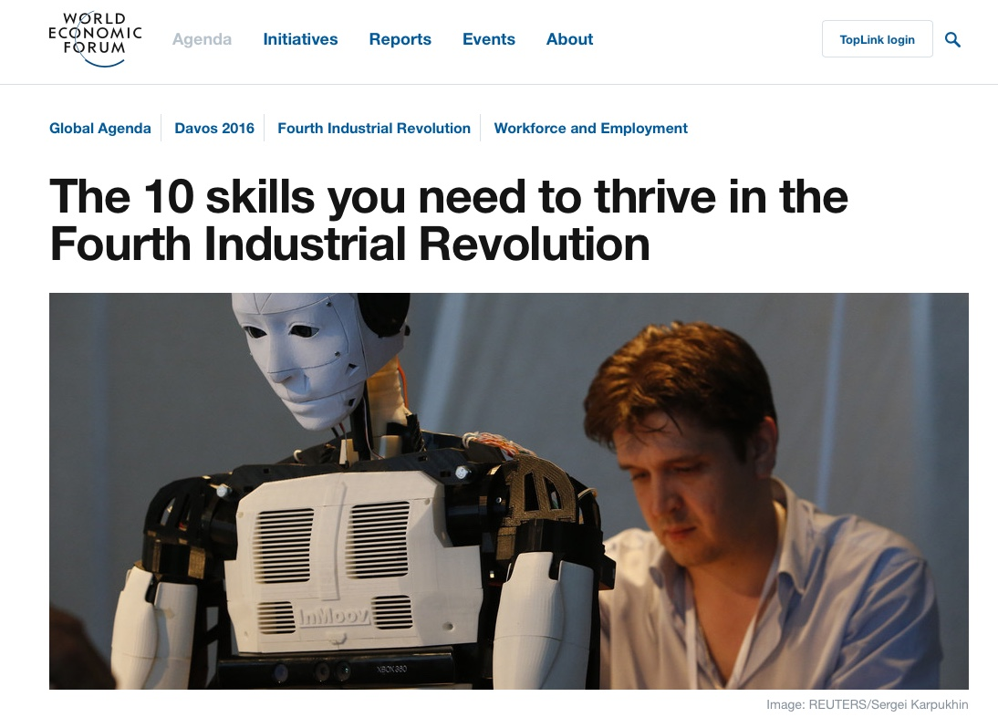
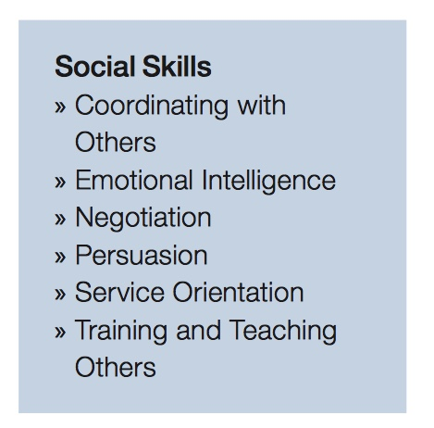
World Economic Forum predict EI will be one of the top 10 employment skills of the future

Slide 3
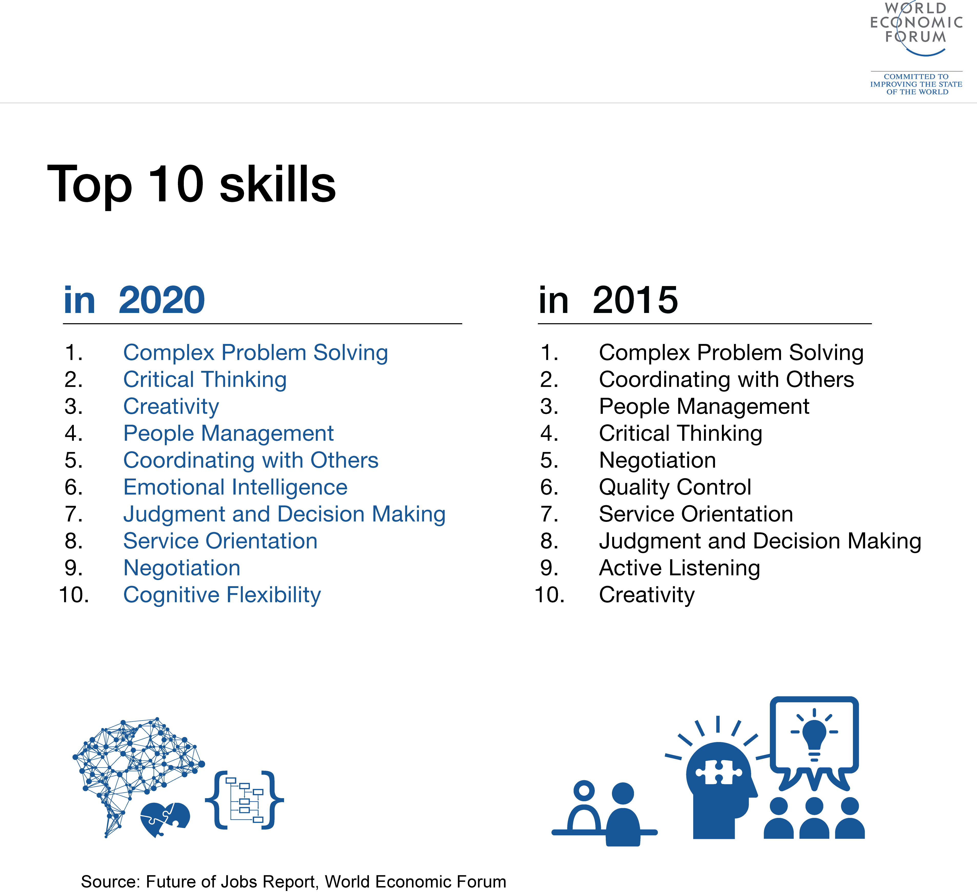
Level of importance into the future

Slide 4
We also know that:
High levels of Emotional Intelligence are associated with:
Better physical and mental health
The development of workplace relationships (Manager, team…)
Helping people cope with high demands and stress
Increased levels of engagement and discretionary effort
Reductions in employee turnover and absenteeism
Increased creativity and innovation

Slide 5

The world of work we live in
Notes:
ASK – The program participants to work in table groups and explore the question on the slide.
EXPAND – on the question by asking participants to list the work related factors that that make their working environments challenging – offer an example e.g., organisational change.
EXPAND – by asking participants to consider the factors.
FACILITATE - a group discussion capturing the key points

Slide 6
The world of work we live in
Do more with less
24/7 work pattern
Higher work demands and stress
Increased complexity and uncertainty
More service oriented = higher levels of emotional labour
More collaborative work = higher levels of emotional labour
Continuous change is the norm (restructures, mergers, new systems, technology and process), AND change creates uncertainty which can facilitate unproductive emotions (e.g., anxiety), consciously and non-consciously
Emotions are now a strong predictor of organisational performance particularly in industries where high levels of emotional labour exist

Slide 7

The way people feel influences, thinking, behaviour and performance
Problem focused
Reactive
Lack of responsibility
Defensive
Blame
Aggressive
Absence of trust
Anxious
Uncertain
Victimised
Stressed
Disempowered
Fearful
Worried
Financial pressures, job insecurity, work hours, job complexity,

Slide 8



The science of emotions
Emotions influence
Decisions
Behaviour
Performance

Slide 9
The science of emotional intelligence
Emotional intelligence is the skill of
  Perceiving
  Understanding
  Expressing
  Reason with, and
  Manage emotions within oneself and others
Applied at work, it’s about using emotions intelligently to achieve desired results

Slide 10
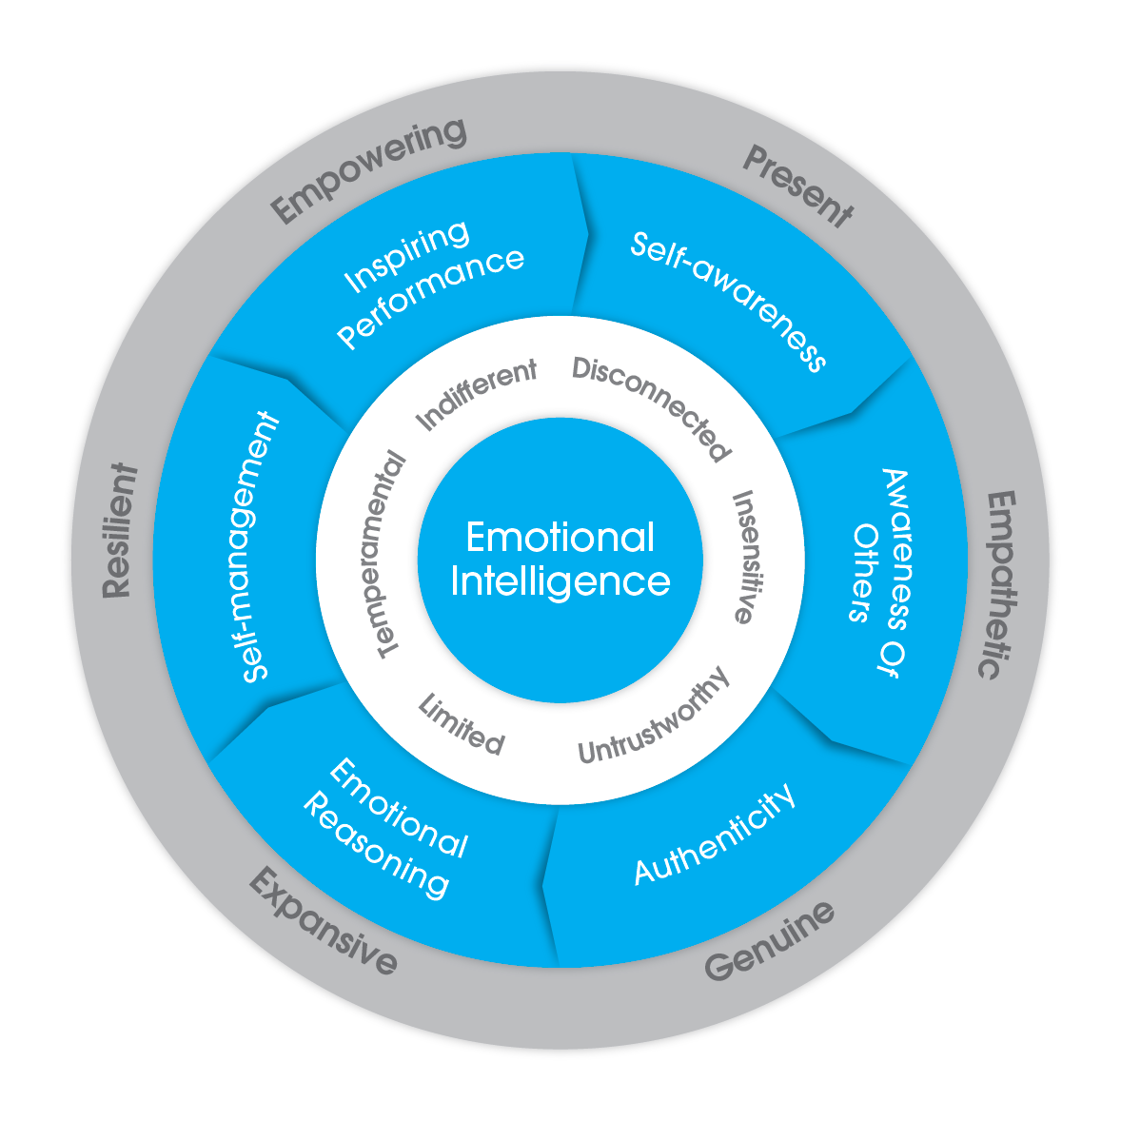
EI applied to leadership
Notes:
So what does emotional intelligence look like when applied to leadership? Emotionally intelligent leadership competencies reflect what leaders do with their emotional intelligence in the leadership of people. The Genos model of emotionally intelligent leadership competencies is shown here and in your workbooks on page 6. The competencies of the model help leaders “be” the productive being states on the outside of the model, as opposed to the unproductive being states, that we can all be at times, on the inside of the model. Lets go through these in turn. You can follow along in your workbooks starting on page 7

Slide 11
Emotional Intelligence
“Emotional Intelligence is about making intelligent responses to negative emotions and using the competencies of the Genos model to generate positive emotions in self and others through being, present, empathetic, genuine, resilient and empowering in our behaviour as often as possible.”
Notes:
Slide’s Objective
To provide participants an official definition of EI
Script
Read from slide
State the these 7 skills represent the Genos model of EI
Note that the book chapter is on the Genos EI Resource Portal and is available for download
Typical FAQs and responses for the Slide

Slide 12
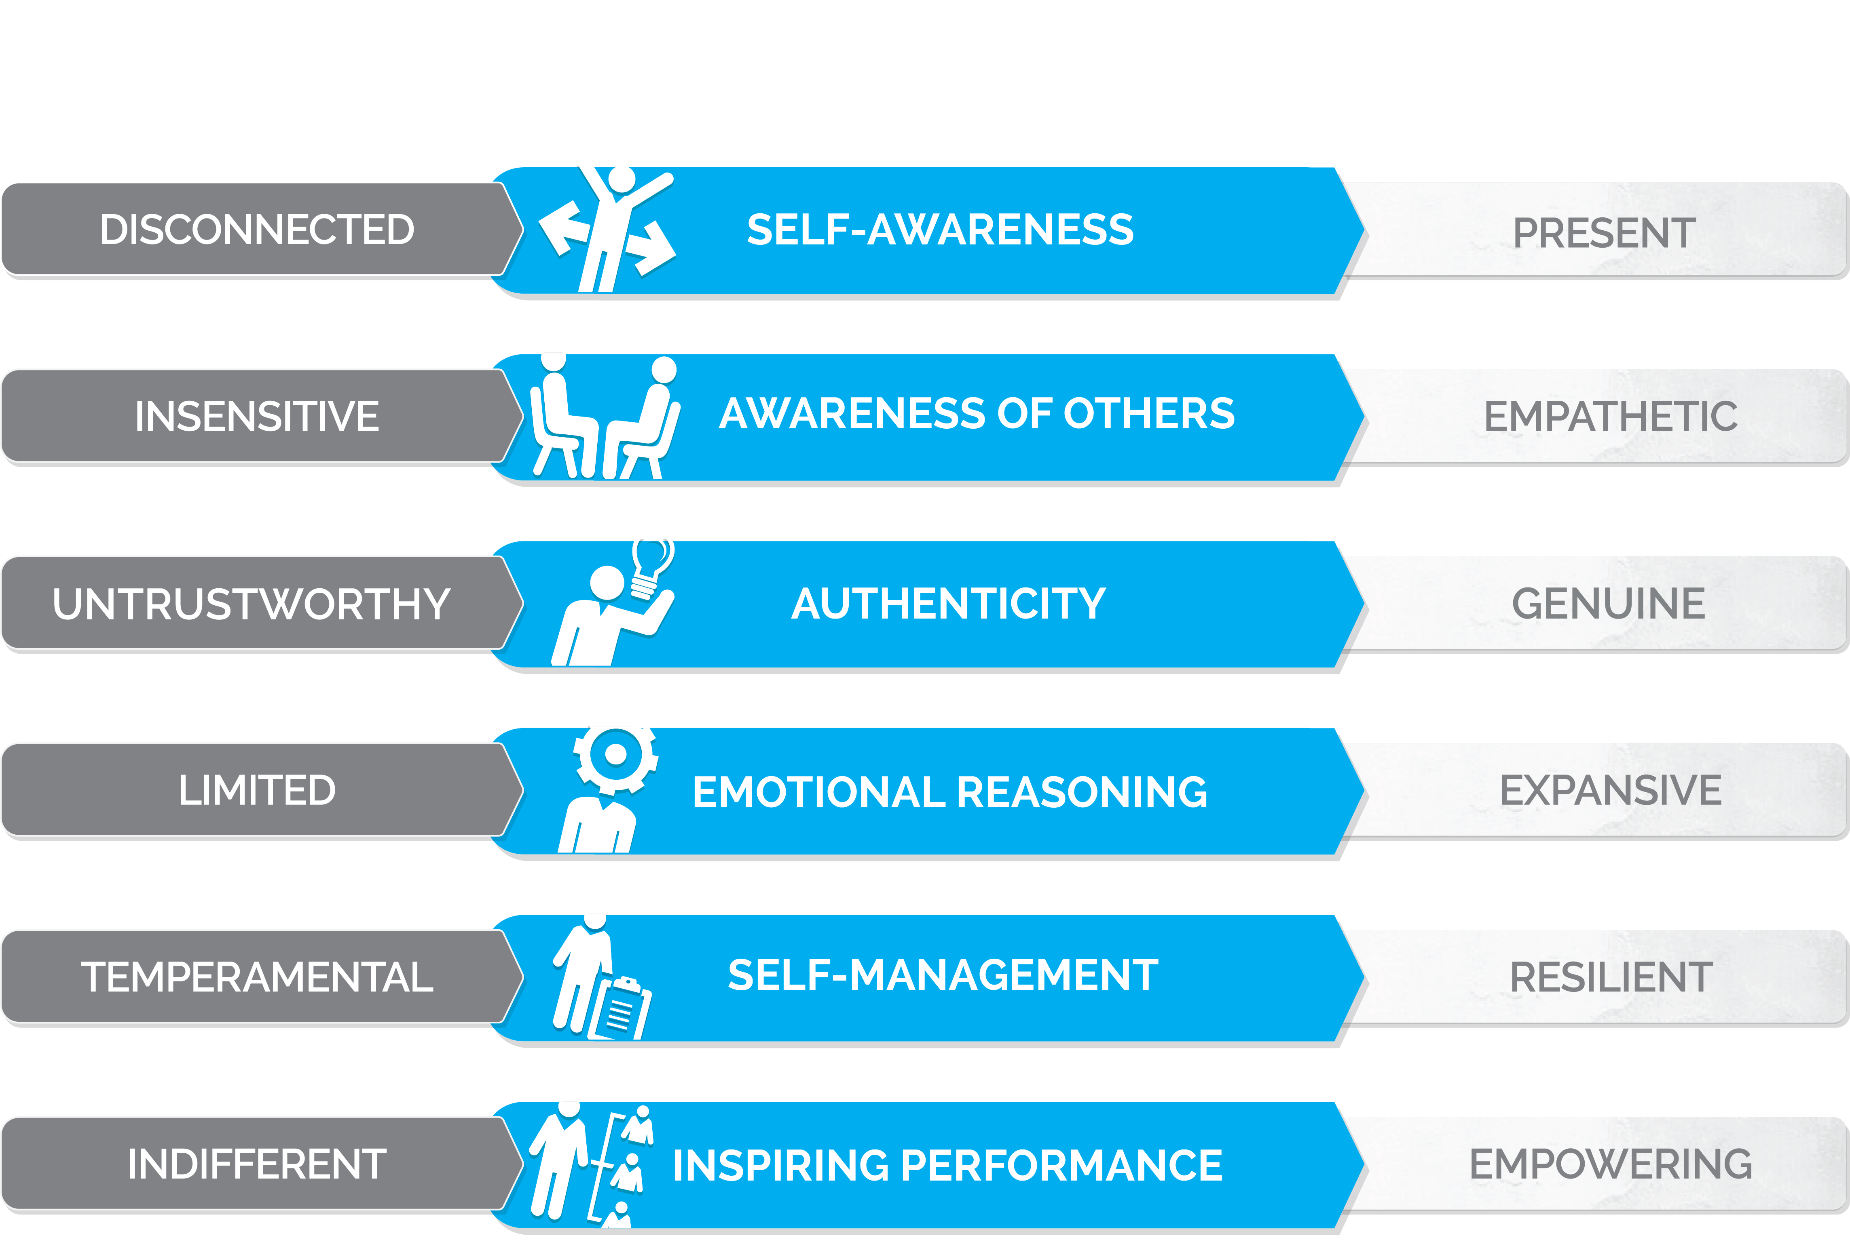
The Genos model of emotional competence

Slide 13
The way people feel influences, thinking, behaviour and performance
Solution focused
Promote the brand
Discretionary effort
Accountable
Buy-in
Engaged
Buy-in
Relaxed
Consulted
Empowered
Purpose
Informed
Cared for
Valued
Financial pressures, work hours, job complexity,

Slide 14

$540,000
$520,000
$500,000
Retail sales per territory ($)
$480,000
$460,000
Development Group
$440,000
Control Group
$420,000
Sep-05
Oct-05
Nov-05
40 Sales Reps in Development Group
30 Sales Reps in Control Group
Returned $6 for every $1 invested within a 6 month timeframe

Slide 15
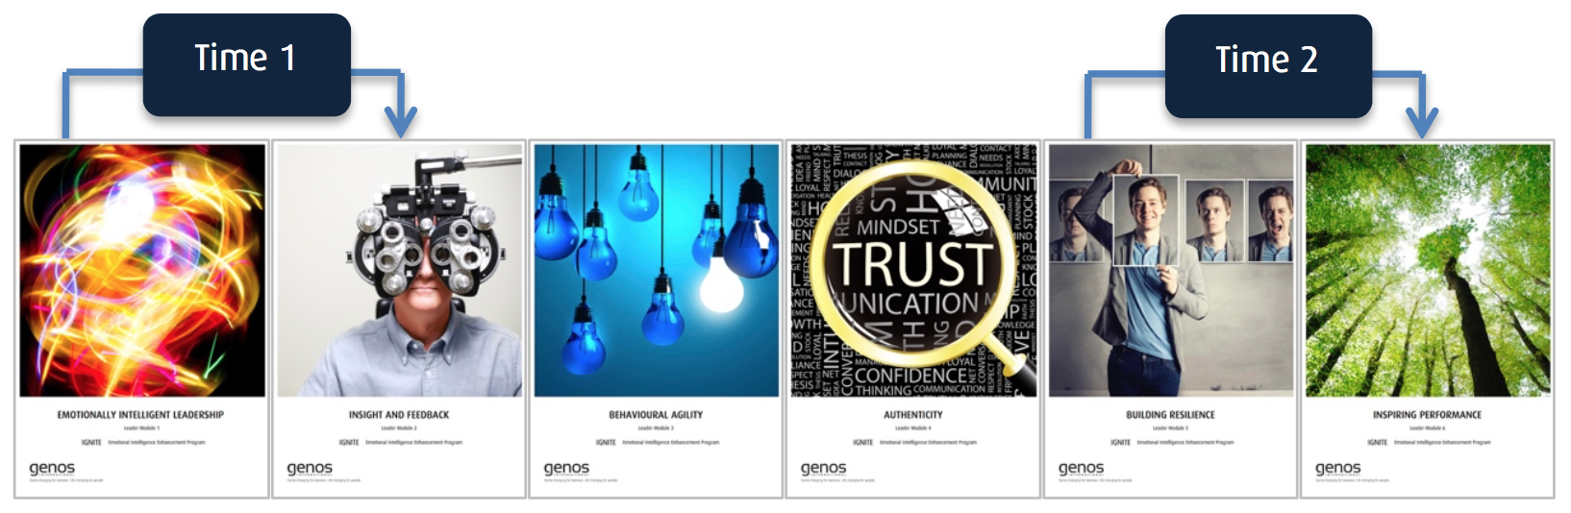
Large State Government Department
Modular Learning Journey
Pre and post EI Assessments
Delivered across 700 leaders

Slide 16
ROI - a 24% improvement in EI

Slide 17
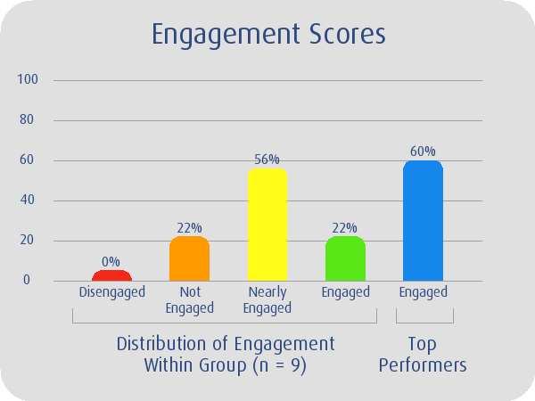
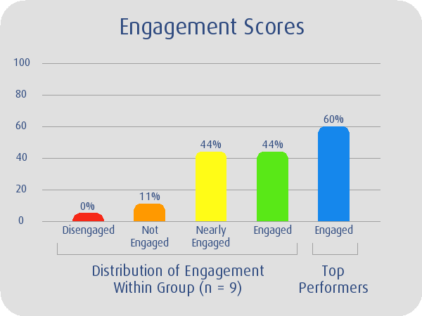
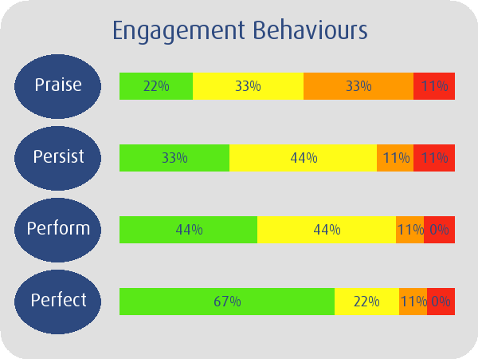
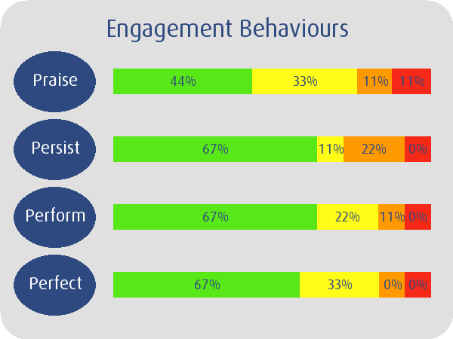
Produced a 22% Increase in employee engagement
TIME 1 TIME 2

Slide 18
Large National Construction Organisation
Driving a high end design, innovation and engineering excellence strategy to differentiate in the market
Moving from a building/ construction culture to one that is diverse, agile, and promotes employee well-being & safety

Slide 19
Their approach:
EI assessment in recruitment of all people leaders (internal and external hires)
All people leaders go through EI development program with 360 assessment and follow-up assessment
EI is a part of all talent management discussions

Slide 20

Questions

Slide 21
Thank you

